Slide 1

BitacorAPP
Academia iOS
Project Manager
Brian Jiménez Moedano
Developers
David Eduardo Batista Trujillo
Alan Badillo Salas
January 2023

Slide 2
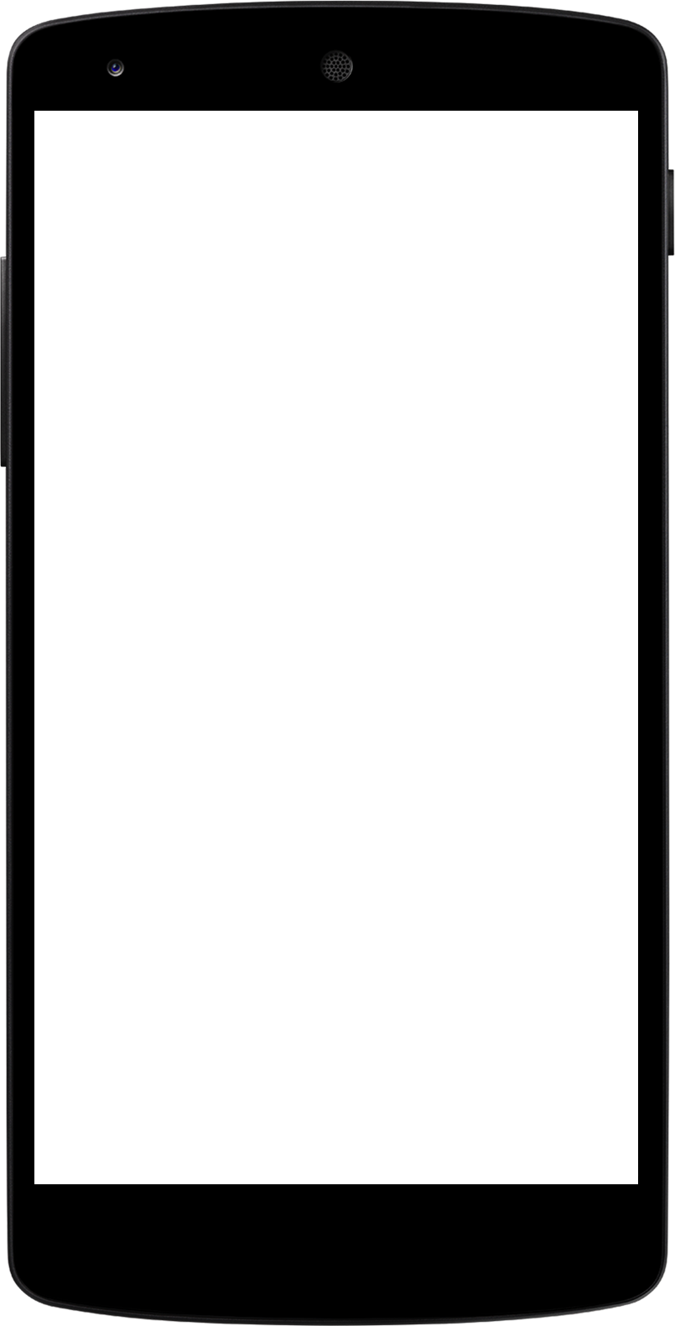
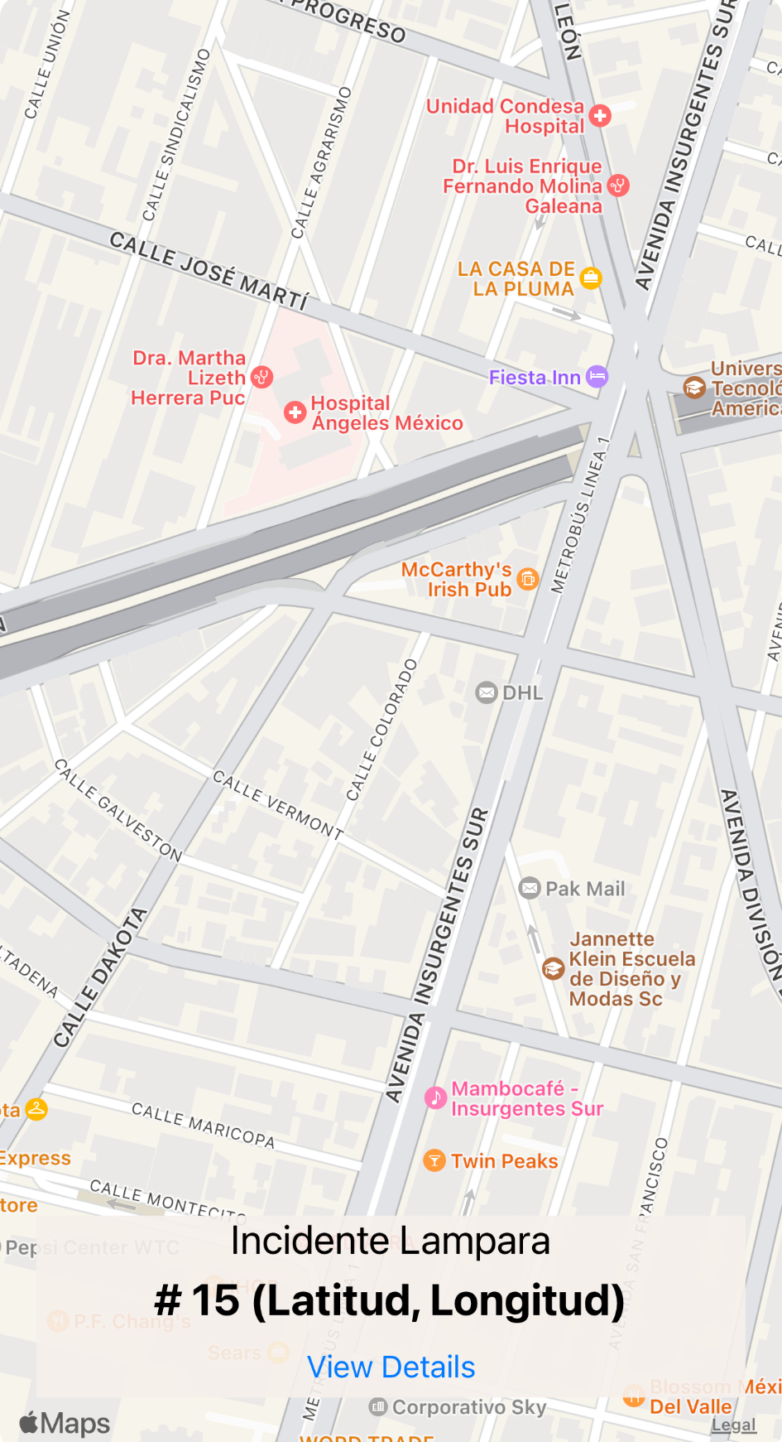
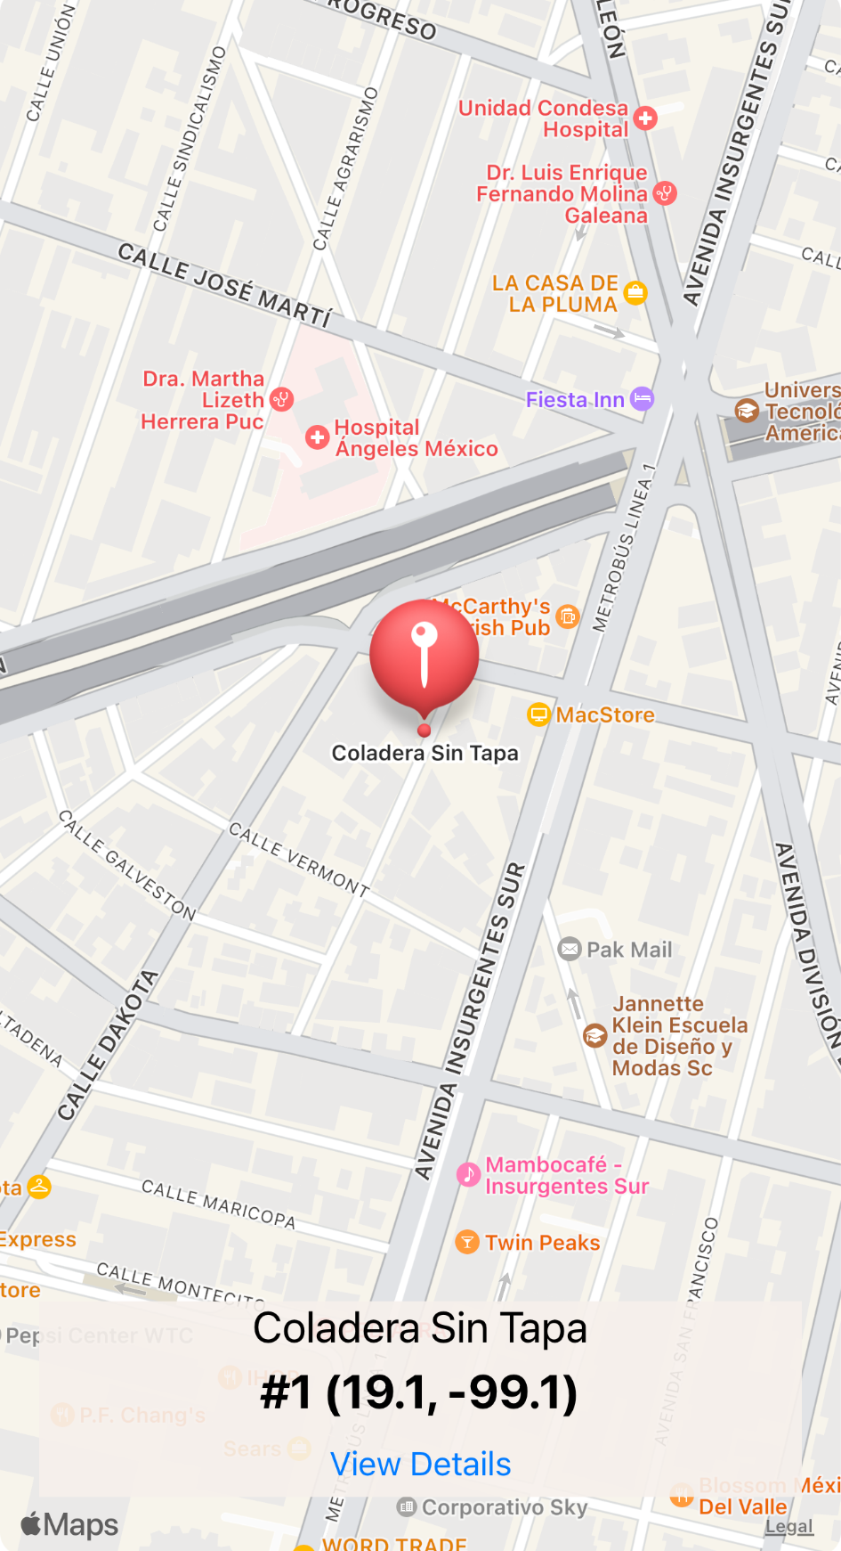

Slide 3
Home View
At the start of the APP, the user is presented with the Home View, where a map is displayed at the current user location.
An overlapped subview is shown at the bottom of the window with the title, id and coordinates of the current selected Bitacora. Also from here, the user may navigate to the Details View with the View Details Button.
The map responds to the user's short and long taps.
A long tap over the map, creates a new Bitacora element, extracting the coordinates from the map, and setting default values to the rest of the Bitacora’s properties. Immediately after, the user is prompt to the Details Window.
Back to the Home View, map is refreshed in order to display a Bitacora mark point, over the newly created Bitacora’s coordinates.
A short tap over a Bitacora mark point, updates the subview with relevant information of the Bitacora element created at that specific mark point.

Slide 4
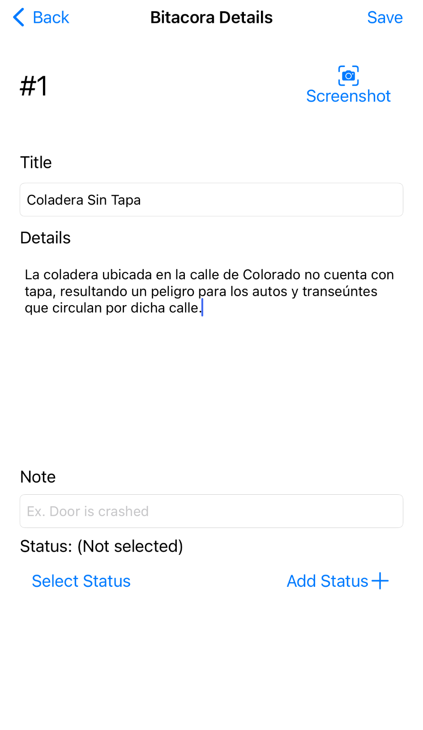
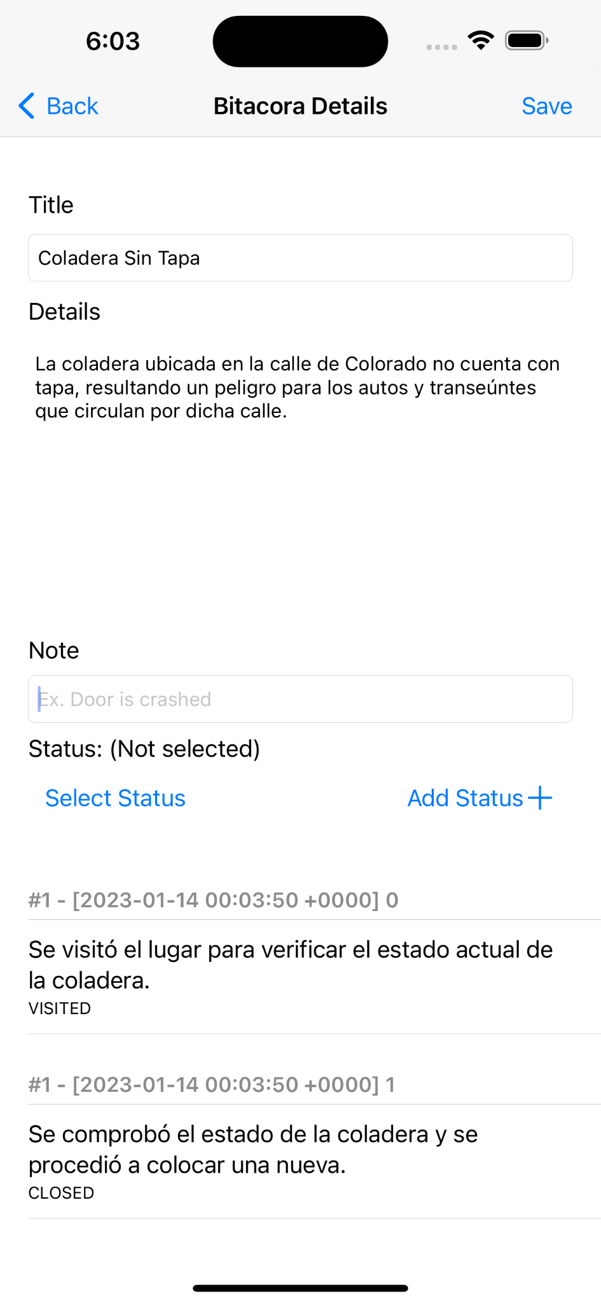

Slide 5
Details View
This view presents the user with all the properties of the Bitacora element previously selected from the Home View map, via a short tap over the Bitacora mark point.
This properties includes: Title and description, which can be edited, as well as ID, coordinates and date of creation, which cannot be edited by the user.
User may add new status to the Bitacora’s status log, as long as the status note field is filled with information, a valid status is selected, and the Add Button is pressed.
At the bottom of the View, the Bitacora’s status log is displayed inside a TableView.
Additionally, the user may save a screenshot to his Photo Gallery with the ScreenShot Button at the upper right corner of the View.

Slide 6
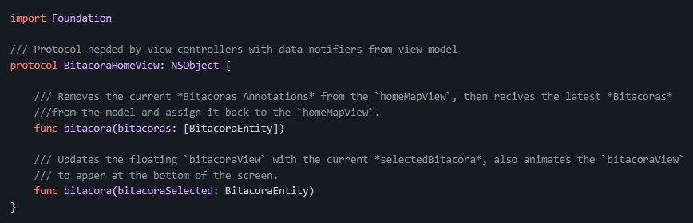
BitacoraHomeView

Slide 7
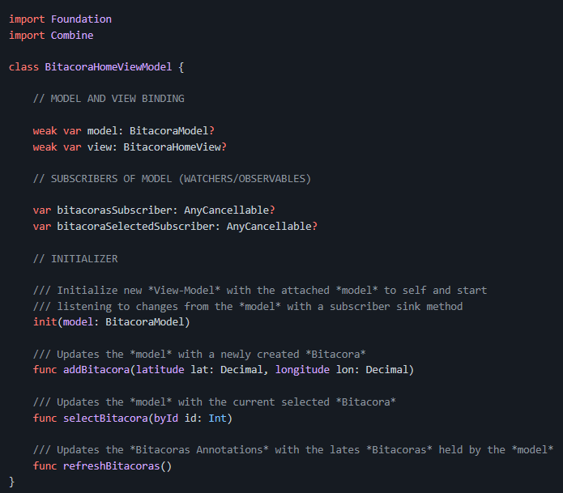
BitacoraHomeViewModel

Slide 8
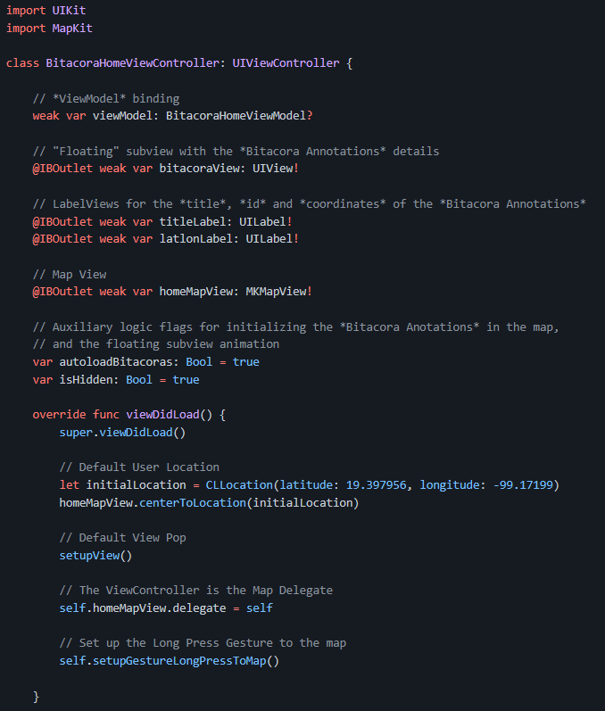
BitacoraHomeViewController

Slide 9
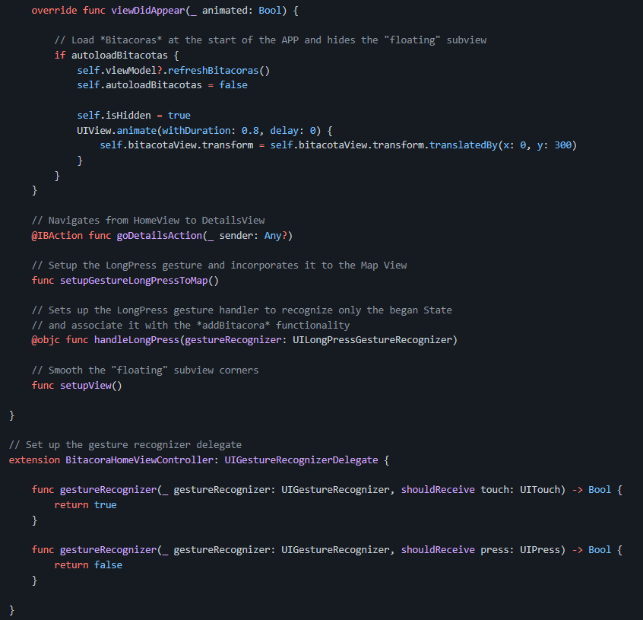

Slide 10
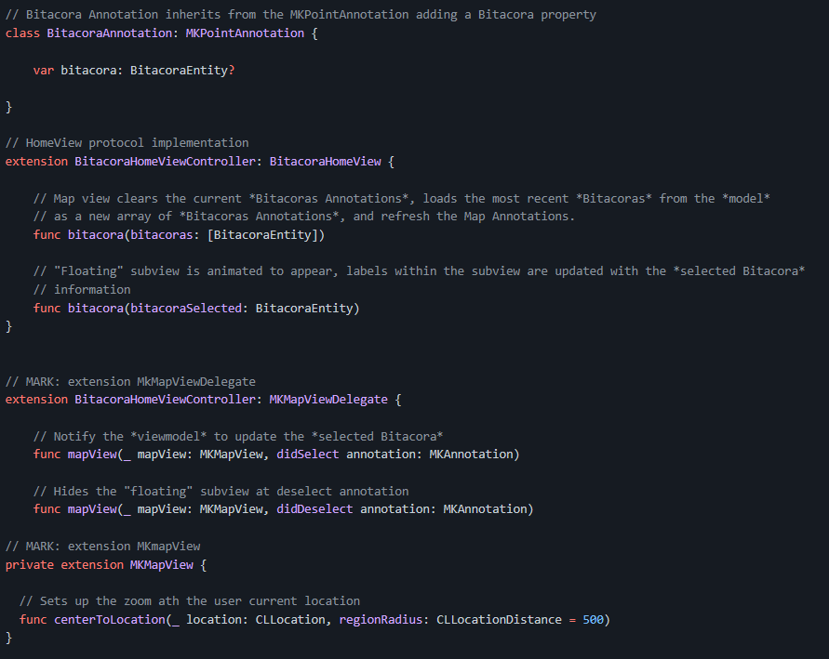

Slide 11
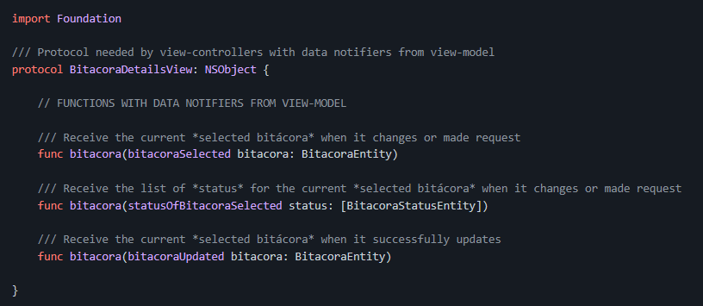
BitacoraDetailsView

Slide 12
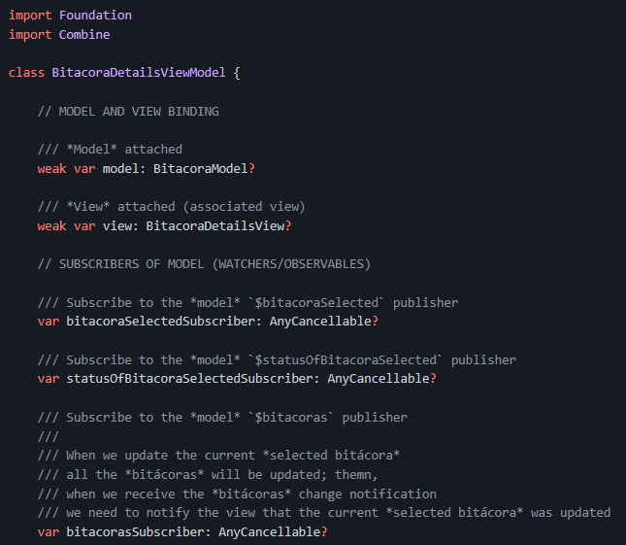
BitacoraDetailsViewModel

Slide 13
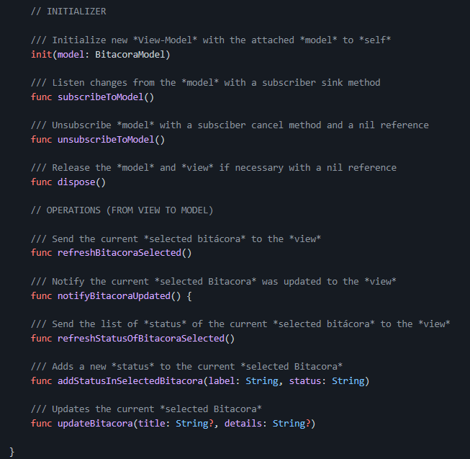

Slide 14
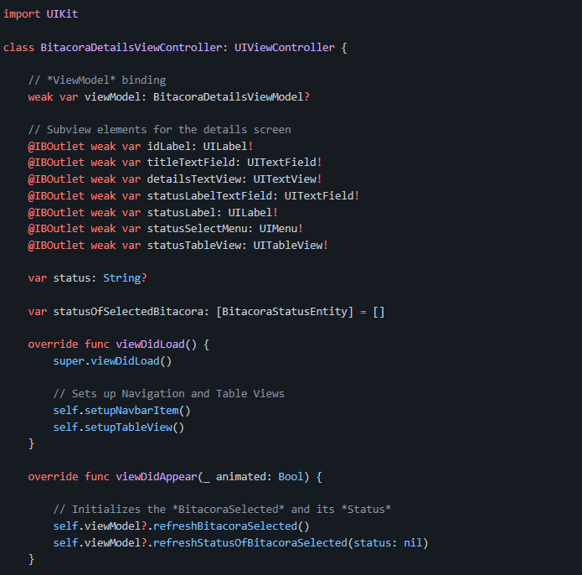
BitacoraDetailsViewController

Slide 15
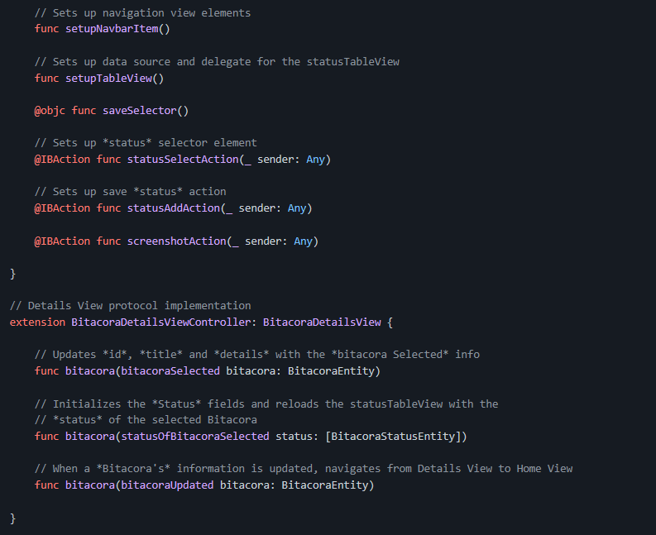

Slide 16
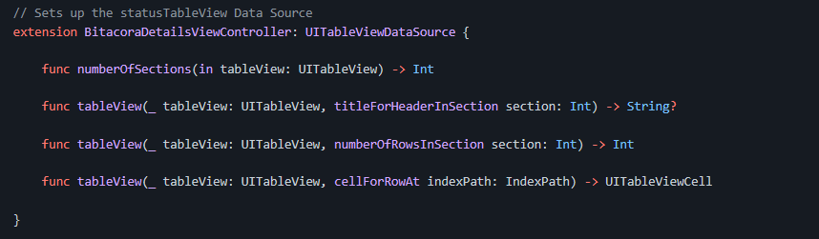

Slide 17

https://github.com/BrianJM21/BitacorAPP.git

